Slide 1
Why Statistics and Data representation
Day 1
2016

Slide 2
Content
Why statistics? [Examples]
What is Data?
Building intuition about data – [Data visualization examples/ video]
Napoleon Map
Florence Nightingale Pie charts
Hans Rosling Video
Data exploration through an example
Knowing your data
Dangers of trusting numerical measures
Simpson’s paradox

Slide 3
Why statistics? Why do you think it is important?
Notes:
[10 minutes]
Start with a question – How do you decide which movie to go to? [IMDB ratings, lead actors, director, storyline, ticket price, closeness of theatre]
Another question – Govt is looking to roll out an aid program –
Give federal aid of $100 million, if the average income <$20,000 dollars per year [To justify]
Time period is in between censuses, so can’t use census data
Will an average be enough? Would you back that with $100 million?
What more do you need to make a decision?
Talk about how you use data to understand and make certain judgements, based on which you take decisions.
Talk about the idea of decision making under uncertainty – We will never have perfect information and hence we make guesses
But how can we understand the uncertainty? ‘Statistics is a measure of your ignorance’
Relate this to the idea of how naturally we learn and make decisions based on experience/ data
Elaborate discussions with the students on why they think that knowing statistics would be interesting for them. Ask them for interesting examples from their day-to-day where and how statistics can be used.

Slide 4
Who will you recommend? – Part I
Mr. Shared Power and Mr. Rash Pilot are two workers contending for a promotion
Each worker can operate six semi-automatic machines simultaneously
They operated a group of six machines (M1 to M6) for six consecutive hours each. The table below gives the average number of units per hour produced by Mr. Shared Power and Mr. Rash Pilot on each machine
The results were summarized by the assistant of Mr. Peevee Yen, the consultant from Yaponandon Consultants
Notes:
[10 minutes]

Slide 5
Who will you recommend? – Part II
Mr. Shared Power and Mr. Rash Pilot are two workers contending for a promotion
Each worker can operate six semi-automatic machines simultaneously
They operated a group of six machines (M1 to M6) for six consecutive hours each. The table below gives the average number of units per hour produced by Mr. Shared Power and Mr. Rash Pilot on each machine
The results were summarized by the assistant of Mr. Peevee Yen, the consultant from Yaponandon Consultants
Notes:
Discuss how we naturally summarize information to understand it, make judgements on it and then take decisions from it
Relate back to the IMDB and government example

Slide 6
Facts!
Both the tables in the previous two slides were created from the same data
Data can be manipulated to make you decide either way
Data has to be looked at in context of the question!
 | Shared Power |  |  |  |  |  | Rash Pilot
Hour | 1 | 2 | 3 | 4 | 5 | 6 | 1 | 2 | 3 | 4 | 5 | 6
M1 | 572 | 570 | 568 | BD | 574 | 570 | 572 | BD | 570 | 572 | BD | 572
M2 | 550 | 548 | BD | 552 | BD | BD | 550 | 554 | 554 | BD | 552 | 550
M3 | 606 | 598 | 600 | 612 | BD | 609 | 610 | 615 | BD | BD | 612 | BD
M4 | BD | 588 | 586 | 588 | 586 | 590 | BD | BD | 588 | 592 | BD | 590
M5 | 543 | BD | BD | BD | 535 | 550 | 560 | 565 | 558 | 545 | 550 | 548
M6 | 548 | 546 | 545 | 540 | BD | 542 | 544 | 542 | 546 | 548 | BD | 548
*BD indicates breakdown
Notes:
Ask the question if the data is relevant
muPDNA without looking into the data
Will the employee perform the same way if given the promotion?
10 breakdowns each – Number of breakdowns?

Slide 7
Statistics starts with question, not with data/information
What is average age of Mu Sigman?
% people coming before 9 AM
# of plates for breakfast and dinner
# of cabs required on Friday
% of error free deliverables to client
Notes:
[5 minutes]
Discuss about muPDNA -> Hypothesis -> Data -> Analysis -> Decisions. Questions lead to data [White board this part]

Slide 8
The scientific method..
Research Question
Generate Theory
Generate Hypothesis
Collect Data
Research Process
Initial observation
Fit a Model
Analyze Data
Notes:
Discuss about muPDNA -> Hypothesis -> Data -> Analysis -> Decisions. Questions lead to data

Slide 9

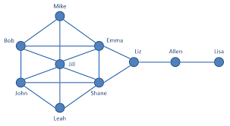
What is Data? Examples of types of data…
Structured data
Unstructured data
Tabular data
Network data
Textual data
Customer | Avg. Sales | Age
A123 | 105.4 | 25
A345 | 110.2 | 35
A112 | 245.3 | 22
A890 | 67.9 | 48
A564 | 97.3 | 28
A887 | 99.1 | 26
Notes:
[5 minutes]
Ask them about what they think data is. Do you think only companies generate data?
Information in raw and unorganized form. Can be processed and analyzed for deriving meaningful insights
Ask them what insights they can draw any meaningful insights from the above images.

Slide 10
The power of data visualization – Napoleon Map
Dimensions of data
Advance and retreat of Groups 1 – 3 of the Napoleon army [Longitude]
Temperature that the troops experienced
Loss of life over time/ location
Map/ Path of the advanced and retreat [Geographically]
Notes:
https://robots.thoughtbot.com/analyzing-minards-visualization-of-napoleons-1812-march
[15 minutes]
Give context on the history
How would you represent this?
[Nightingale pie charts]
[Principles of a visualization]

Slide 11
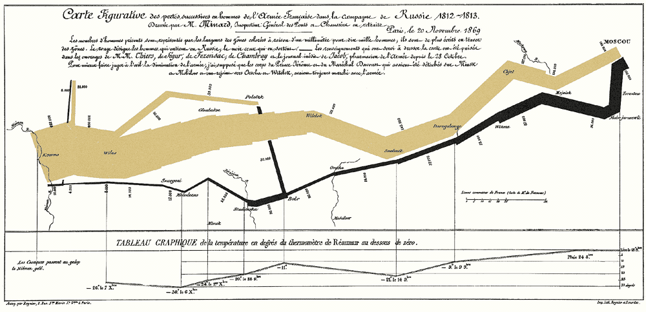
Minard’s graphic
Notes:
Ask about how many dimensions there are in the data.
Discuss how all the information tells a complete and relevant story of the march
Discuss about what the author chose to include/ vs. exclude
He excluded details of terrain [topological] – Doesn’t add value

Slide 12
The power of data visualization – Nightingale pie charts
Notes:
[10 minutes]

Slide 13
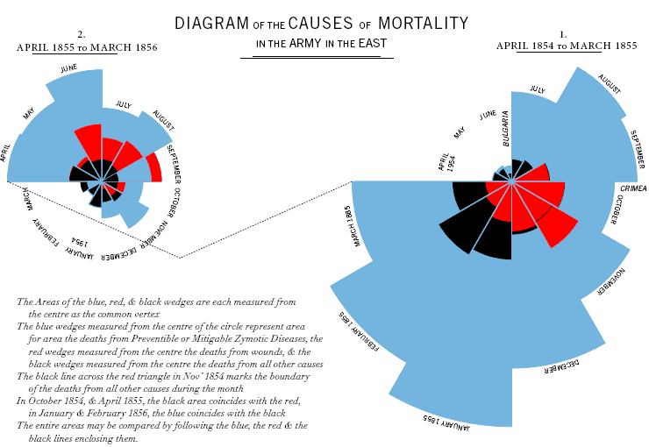
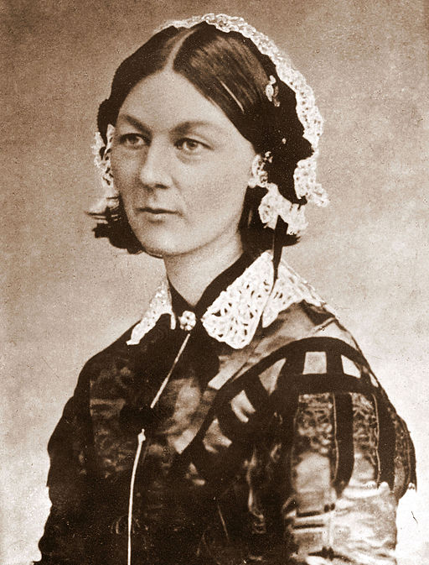
Making graphical representations brings home the message
Florence Nightingale
There are many different ways to represent data
One of the most imaginative ways was invented by Florence Nightingale (1820-1910) in 1857
Nightingale Roses were used to represent the cause of death of British soldiers in each month during the Crimean war
Notes:
Talk about the message the Florence Nightingale was trying to communicate.
Explain the chart and how it gain captures multiple dimensions
Have a discussion on what the students think of the characteristics of the chart
http://www.uh.edu/engines/epi1712.htm

Slide 14
Data visualization – Hans Rosling
Notes:
[15 minutes] – Watch before In between 1 and 2]
https://www.youtube.com/watch?v=hVimVzgtD6w
Changes in preconceived notions
Brilliant analysis but poor communication of results
Talk about the idea of storytelling, communicating insights from data
How data can help us understand the world and hence help us make decisions
Talk about business examples – In a complex Fortune 500 company, how can people make decisions? (Experts, intuition)
Business intuition might be wrong, the world might have changed. How can business understand what are the right decisions to make

Slide 15
Knowing your purpose drives all other decisions in creating your table or graph
Know purpose
Ensure integrity
Maximize data ink; minimize non-data ink
Show your data; annotate
J
You need to have a purpose statement for every table or graph you create and design the display to serve the purpose
Ensure that the information is correct and that it is presented in a way that doesn’t distort the truth.
Avoid heavy grids, excess tick marks, redundant representation of simple data, shadows etc.
Don’t hide data…show it. And consider annotations to help explain what data means
Notes:
Talk through the principles of visualization by relating back to the examples.

Slide 16
Variables and scales of measurement

Slide 17
Scales of Measurement
Variable
Nominal
Ordinal
Ratio Scale
Interval Scale
Notes:
Categorical: Categorical variables are qualitative measurements of samples or populations that are classified into groups:
Ordinal categorical variables are qualitative descriptions that have a natural arrangement or order of the measurements -- e.g., rank in college (freshman, sophomore, junior, senior), size of soda (small, medium, large), etc.
Not ordinal (or nominal) variable is a categorical variable that does not have a naturally imposed (or meaningful) order of its values -- e.g., gender, race, political affiliation (democrat, republican, independent, green party, other), etc.
Quantitative: Quantitative variables are measurements that have a meaningful numerical value representation. There are two types of quantitative variables:
Continuous variables indicate numerical observations that contain intervals with infinite (uncountable) possible values - e.g., weight, height, time, speed, etc.
Discrete: Discrete variables are also numerical measurements, but they are sparse in space and any interval will contain at most countably many possible values -- e.g., number of students in a school, number of rational numbers in a given interval [a ; b], age, etc.

Slide 18
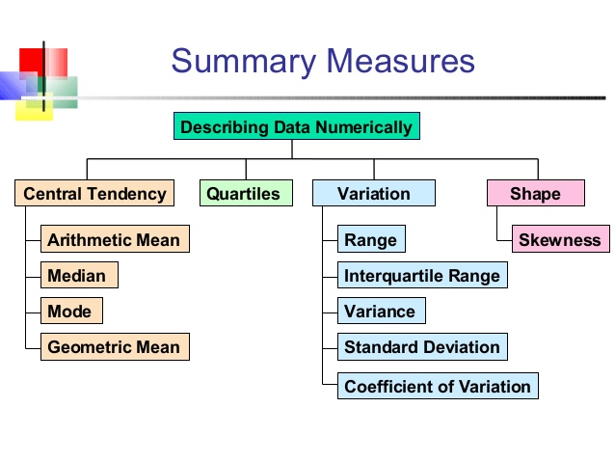
Summarizing data
Notes:
[10 minutes]
Sometimes you might want to summarize and describe the collected data similar to a doctor
Relate back to questions on how you make decisions [IMDB rating is an average, etc.]
Ask questions and discuss the definitions of all these measures through examples. Use the whiteboard to discuss this.

Slide 19

Consider a dataset, detailing the salaries of the players of two MLB National League teams - the Washington Nationals and the New York Mets.
Player | Salary (in millions $) | Position | Team
Adam LaRoche | 8 | Baseman | Washington Nationals
Andres Torres | 2.7 | Outfielder | New York Mets
Brad Lidge | 1 | Pitcher | Washington Nationals
Brett Carroll | 0.6 | Outfielder | Washington Nationals
D.J. Carrasco | 1.2 | Pitcher | New York Mets
Daniel Murphy | 0.5 | Baseman | New York Mets
Chris Marrero | 0.5 | Baseman | Washington Nationals
Craig Stammen | 0.5 | Pitcher | Washington Nationals
D.J. Carrasco | 1.2 | Pitcher | New York Mets
Daniel Murphy | 0.5 | Baseman | New York Mets
Player name
Salary
Position
Team
Question 1: Which team allocated their payroll better? [in terms of final results]
Question 2: What is the right payroll allocation strategy to perform better in the league?
The data depicts the salaries of players of Washington Nationals and New York Mets for the Year 2012 (Courtesy: USA Today). Data shown are first 10 points of the dataset.

Slide 20
How do we get an initial idea about the salaries of the players?
Player | Salary (in millions $) | Position | Team
Adam LaRoche | 8 | Baseman | Washington Nationals
Andres Torres | 2.7 | Outfielder | New York Mets
Brad Lidge | 1 | Pitcher | Washington Nationals
Brett Carroll | 0.6 | Outfielder | Washington Nationals
D.J. Carrasco | 1.2 | Pitcher | New York Mets
Daniel Murphy | 0.5 | Baseman | New York Mets
Chris Marrero | 0.5 | Baseman | Washington Nationals
Craig Stammen | 0.5 | Pitcher | Washington Nationals
D.J. Carrasco | 1.2 | Pitcher | New York Mets
Daniel Murphy | 0.5 | Baseman | New York Mets
Average player salary
$ 3.06 million
Does this help us completely understand the salaries of the players?
We need to look understand the salary spread better in each of the teams to get a more accurate picture

Slide 21
What does the plot of average salary across teams tell us?
The Mets have a much higher average salary as compared to the Nationals.
3.46
2.71
This makes sense as the Mets were a much bigger and better known MLB franchise at that point
Aggregations like mean, sum, etc. can summarize across information variables

Slide 22
How does the average salary vary across different positions?
We see that on average, outfielders earn the most
Pitchers and basemen come in second in terms of average salary

Slide 23
Lets look at spends of both the teams across positions
The Mets spend much more on pitchers and outfielders as compared to the Nationals
This might be misleading as the teams might have different budgets
The Mets have a much higher total budget than the Nationals (Difference of almost $ 13 million)

Slide 24
Let’s look at the allocation of the payroll budget by both teams
Mets spend a higher proportion on pitchers while the Nationals spend a higher proportion on basemen
Courtesy: USA Today
Cross sections can generate key insights from data in a simple and effective manner

Slide 25
Looking at the results…
NL East | W | L | PCT | GB | HOME | ROAD
Washington Nationals | 98 | 64 | .605 | — | 50–31 | 48–33
Atlanta Braves | 94 | 68 | .580 | 4 | 48–33 | 46–35
Philadelphia Phillies | 81 | 81 | .500 | 17 | 40–41 | 41–40
New York Mets | 74 | 88 | .457 | 24 | 36–45 | 38–43
Miami Marlins | 69 | 93 | .426 | 29 | 38–43 | 31–50
Looking at the 2012 season results (from secondary research) we see that focus on a better infield defence is perhaps a winning strategy
The Nationals have allocated their resources more efficiently, as they ended up winning the league that year
Trend over time saw a huge dip in Mets spending and increase in Nationals spending. Today, the Nationals have a much higher budget/ spend as compared to the Mets

Slide 26

In 1936 US presidential election, The Literary Digest predicted that Landon will win with 57.1% of the votes against Roosevelt
Roosevelt won the election with 60.8% of the popular vote
Landslide victory with wins in 46 out of 48 states, losing only to Maine and Vermont
Approximately 10 million questionnaires were mailed to prospective voters, making the Literary Digest poll one of the largest ever conducted
Approximately 2.3 million responded
Prospective voters were chosen from the subscription list of the magazine, from automobile registration lists, phone lists, club memberships, etc.
Using similar technique, The Literary Digest had predicted correctly in the last four elections
Notes:
[10 minutes]
Why did this happen? Why did they fail? Have a discussion on possible reasons
People selected were from middle, upper middle class
It was right after the great depression!
Non response bias. Learnt only about the people who wanted to respond
https://www.math.upenn.edu/~deturck/m170/wk4/lecture/case1.html

Slide 27
Take a look at this study to evaluate treatments for kidney stones…
Size / Treatment | Treatment A | Treatment B
Overall result | 78% (273/350) | 83% (289/350)

Slide 28
Simpson’s paradox
Size / Treatment | Treatment A | Treatment B
Small Stones | Group 1 93% (81/87) | Group 2 87% (234/270)
Large Stones | Group 3 73% (192/263) | Group 4 69% (55/80)
Both | 78% (273/350) | 83% (289/350)
The lurking variable here is the severity of the kidney stone which influences the doctor’s decision to choose a treatment
This is an example of how data can lead to the wrong causal conclusions
Notes:
[10 minutes]
Ask how this is possible?
Adding another dimension changes everything!
Lurking variable is the severity of the case
Treatment B is simple, treatment A is open surgery
Doctors prefer treatment B for simple cases
Treatment A for more sever cases
When the less effective treatment (B) is applied more frequently to less severe cases, it can appear to be a more effective treatment.
As humans, we think in two dimensions, but the truth might be completely different
https://en.wikipedia.org/wiki/Simpson%27s_paradox#Kidney_stone_treatment

Slide 29
Why should we not take a naïve view of numbers?
You can be fooled by numbers
Since 1980’s researchers have described numerous statistical fallacies and misconceptions in peer reviewed scientific literature
Misinterpreted p-values have caused numerous false positives
You need to learn how to communicate the numbers sincerely
Poor statistical education have led scientists to conclude that most published research findings are probably false
Errors have massive impact on the real world
Clinical trials determine the safety of prescription drugs
Marketers and business managers find best ways to sell products
We have embraced all the statistical tools available to us – however we have failed to embrace the statistical education that is required

Slide 30
Appendix

Slide 31

Wrong turns on red – perils of incorrect inference
Virginia Dept. of Highways and Transportation studied accidents at 20 intersections
In 1973, many cities in US started allowing drivers to turn right at a red light
Several studies were conducted to consider the safety impact of the change
The studies were not statistically significant leading to the conclusion that there was no impact on safety of pedestrians and bicyclists
These studies were later found to be severely underpowered – a blunder which led to loss of lives due to accidents at accidents
Notes:
[5 minutes]

Slide 32

Sally Clark – The case of inexpert witness
Solicitor Sally Clark was tried in 1999 for the murder of two children (Christopher, 11 weeks & Harry, 8 weeks)
Clark’s first son died suddenly few weeks of his birth in Sep, 1996
Harry died in similar manner in Dec, 1998
The prosecution case relied on the statistical evidence presented by paediatrician Professor Sir Roy Meadow, who testified that the chance of two children from an affluent family suffering sudden infant death syndrome was 1 in 73 million

Slide 33
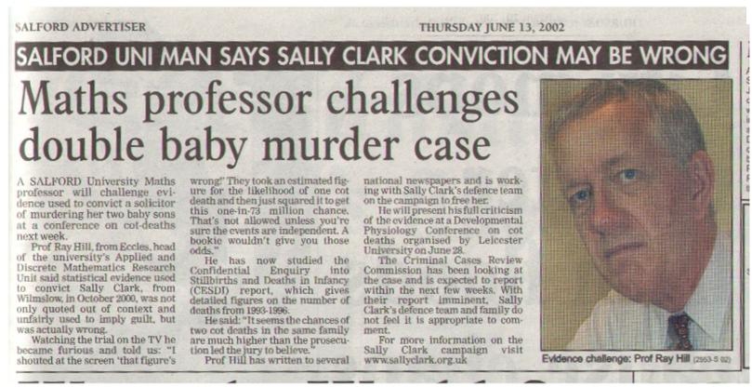
Clark was released in 2003 but dies of alcohol poisoning in 2007

Slide 34
Why should we not take a naïve view of numbers?
You can be fooled by numbers
Since 1980’s researchers have described numerous statistical fallacies and misconceptions in peer reviewed scientific literature
Misinterpreted p-values have caused numerous false positives
You need to learn how to communicate the numbers sincerely
Poor statistical education have led scientists to conclude that most published research findings are probably false
Errors have massive impact on the real world
Clinical trials determine the safety of prescription drugs
Marketers and business managers find best ways to sell products
We have embraced all the statistical tools available to us – however we have failed to embrace the statistical education that is required

Slide 35


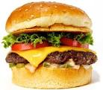

Cause and Effect
Let us take an example:-
Ram is worried about his body weight. He thought for a while and found out it might be due to the three major reasons:-
Work timings
Diet
Lack of exercise
In the above examples, work timings, diet and lack of exercise acts as the independent variables effecting the weight of Ram which is a dependent variable
Notes:
This is an important concept. Use multiple examples to make them understand the difference between the dependent and the independent variables.

Slide 36
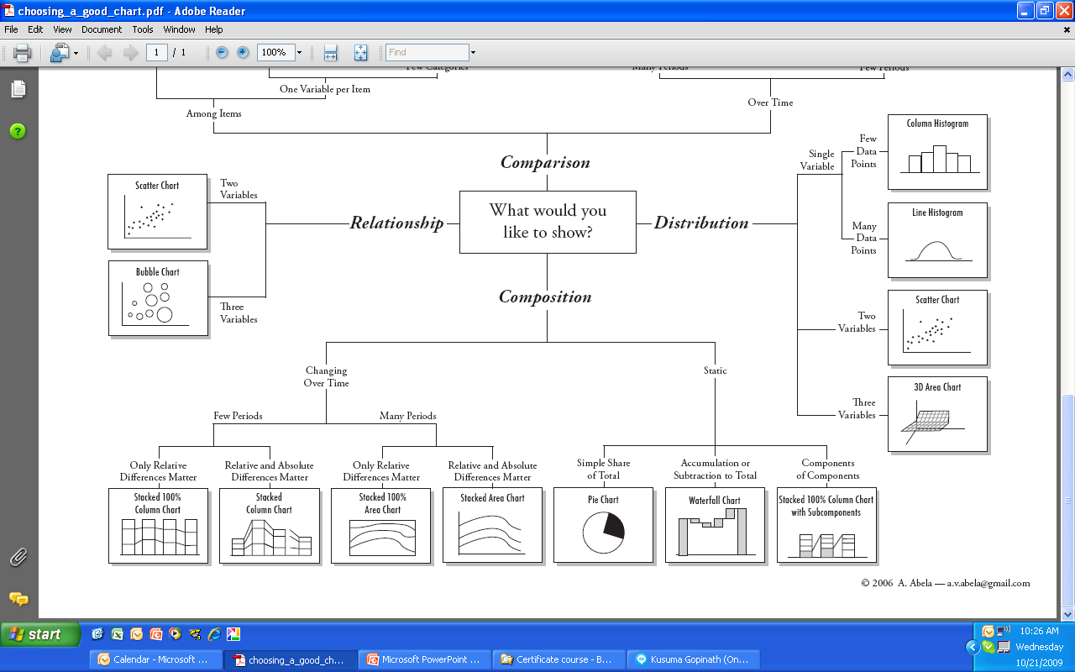
Choosing the right picture - Composition
Composition
Changing over time
Static
Few periods
Many Periods
Only relative difference matter
Relative and absolute difference matter
Only relative difference matter
Relative and absolute difference matter
Simple Share of Total
Accumulation or subtraction to total
Components of Components
Stacked 100% Column Chart
Stacked Column Chart
Stacked 100% Area Chart
Stacked Area Chart
Pie Chart
Waterfall Chart
Stacked 100% column chart with subcomponents

Slide 37
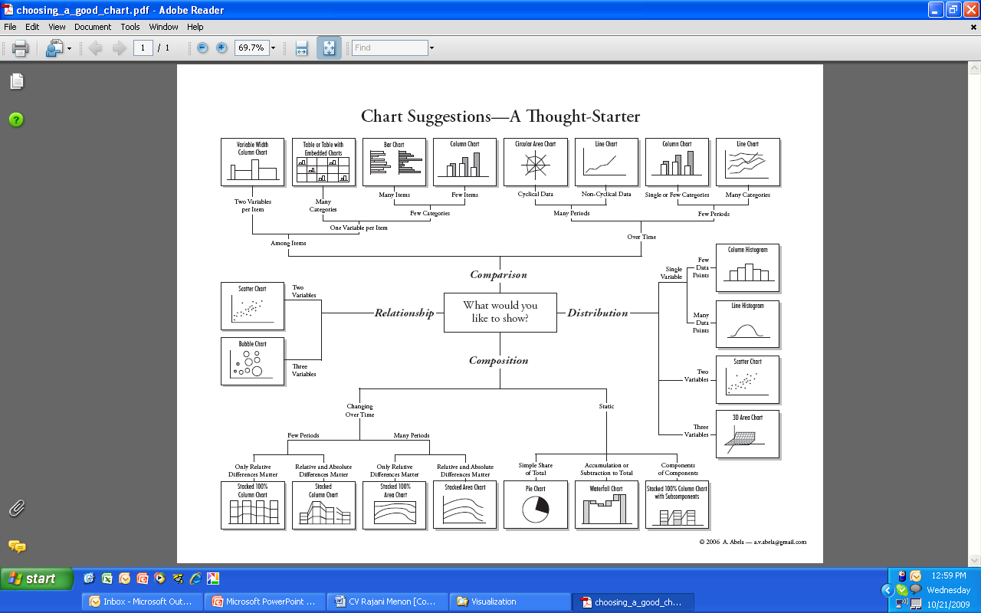
Choosing the right picture - Distribution
Column Histogram
Single Variable
Few data
points
Line Chart
Many data
points
Distribution
Scatter Chart
Two Variables
3D Area Chart
Three Variables

Slide 38
Choosing the right picture – Relationship
Two Variables
Scatter Chart
Relationship
Bubble Chart
Three Variables

Slide 39
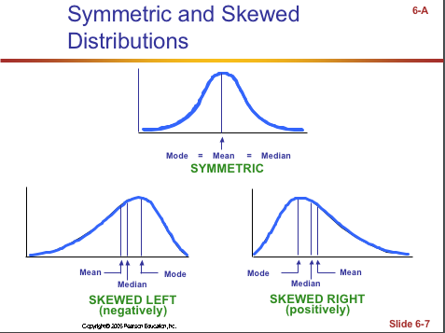
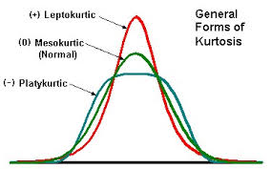
Shapes (Skewness and Kurtosis)
Kurtosis
Skewness

Slide 40
Variables – Part I
Example #1: Can blueberries slow down aging?
A study indicates that antioxidants found in blueberries may slow down the process of aging. In this study, 19-month old rats (equivalent to 60-year old humans) were fed either their standard diet or a diet supplemented by either blueberry, strawberry, or spinach powder. After eight weeks, the rats were given memory and motor tests. Although all supplemented rats showed improvement, those supplemented with blue berry powder showed the most notable improvement. 1. What are the independent variables? 2. What is the dependent variable?
Notes:
13 + 14 + 15– [10 minutes]
Discuss what are dependent and independent variables in these questions

Slide 41
Variables – Part II
Example #2: How bright is right?
An automobile manufacturer wants to know how bright brake lights should be in order to minimize the time required for the driver of a following car to realize that the car in front is stopping and to hit the brakes. 1. What are the independent variables? 2. What is the dependent variable?

